Slide 1
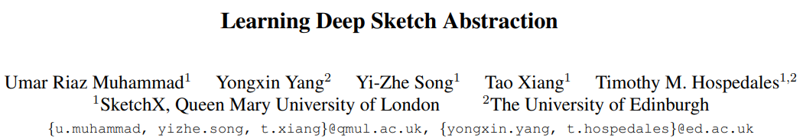
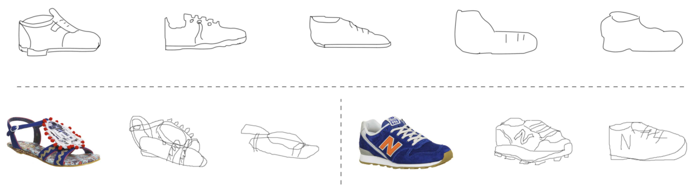

Slide 2
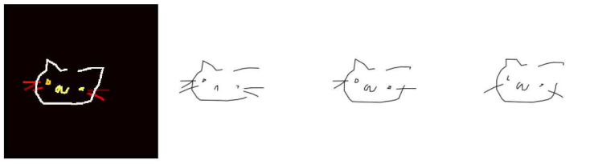
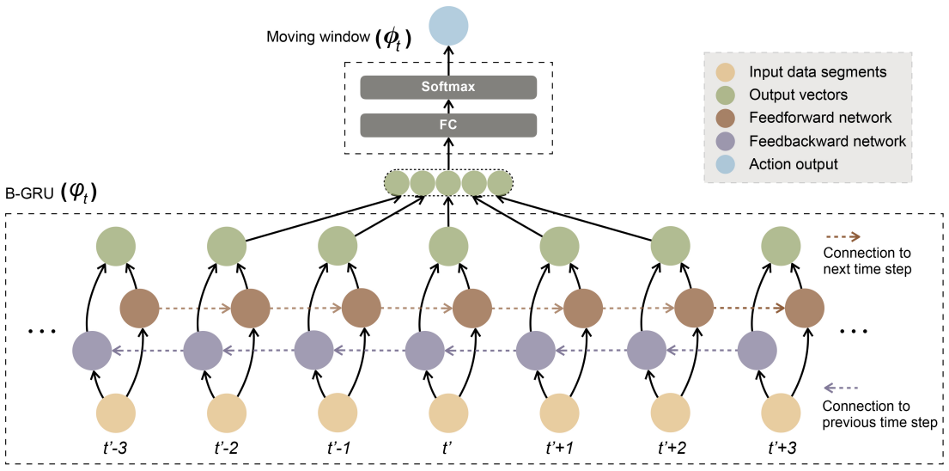
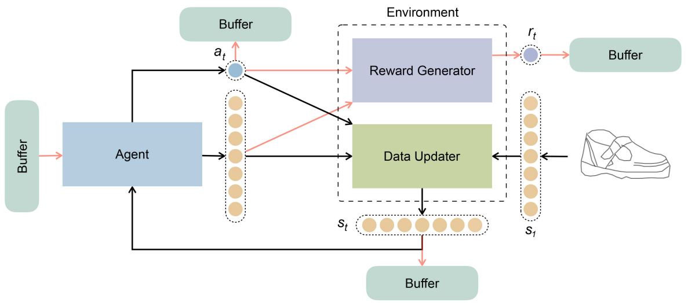

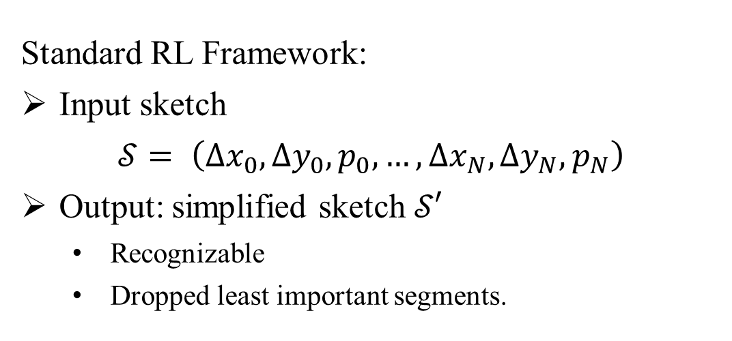
Standard RL Framework:
Input sketch
$$𝒮= \left(∆x_{0}, ∆y_{0}, p_{0},…,∆x_{N}, ∆y_{N}, p_{N}\right)$$
Output: simplified sketch $𝒮′$
Recognizable
Dropped least important segments.
For each stroke segment in one sketch $𝒮$,
the agent choose to:
remove the segment from $𝒮$
keep the segment untouched

Slide 3
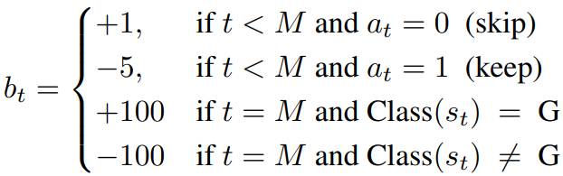
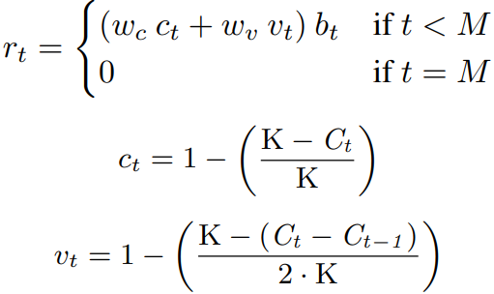
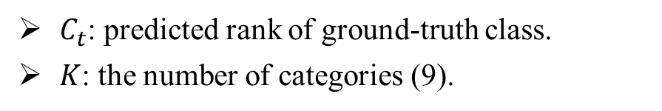
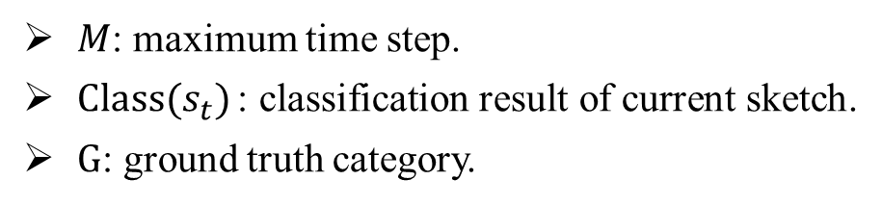

Dataset: QuickDraw
70000 sketches per category
9 categories.
Reward Scheme:
Drop least important segments while still recognizable.
Use a 3-layer LSTM classifier to guarantee recognizability.
$$R_{t}=ω_{b}b_{t}+ω_{r}r_{t}$$
$M$: maximum time step.
$Class(s_{t})$: classification result of current sketch.
$G$: ground truth category.
$C_{t}$: predicted rank of ground-truth class.
$K$: the number of categories (9).

Slide 4
Result:
Classifier achieves 90% categorization accuracy.
Failed on reproducing the abstraction agent:
Converged too fast.
Incorrect choice of Policy Gradient Method
Sparse reward space.

